Slide 1


Slide 2
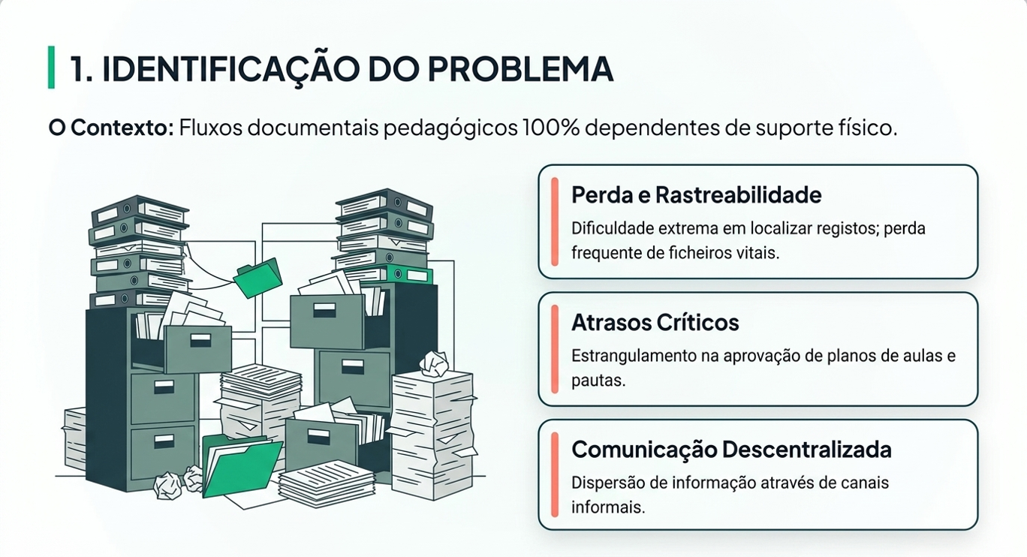

Slide 3
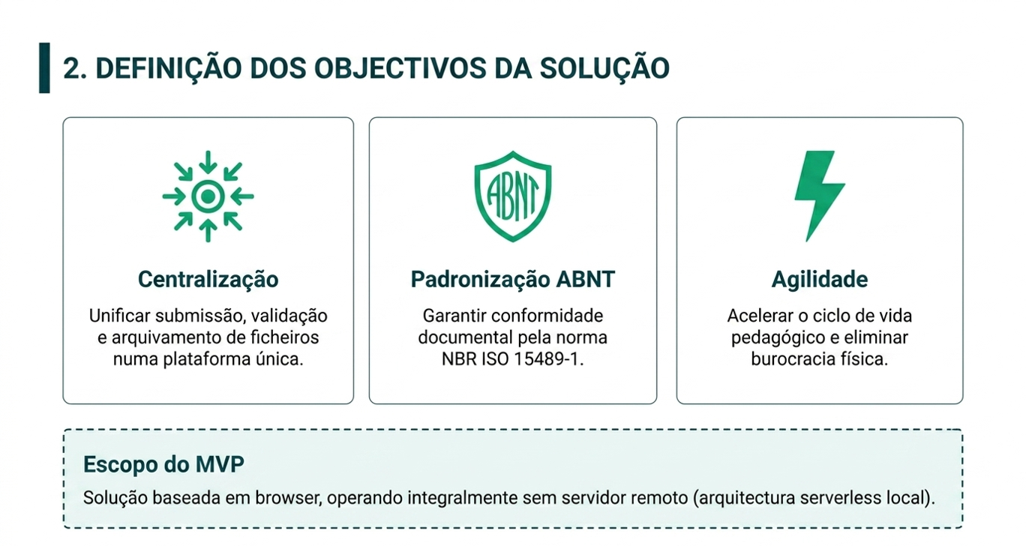

Slide 4
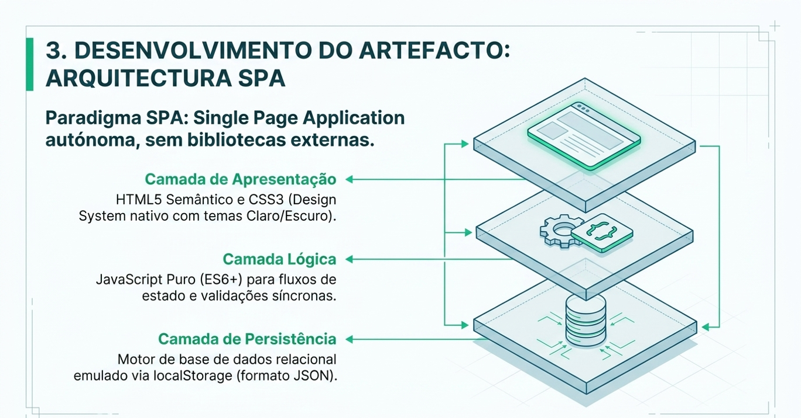

Slide 5
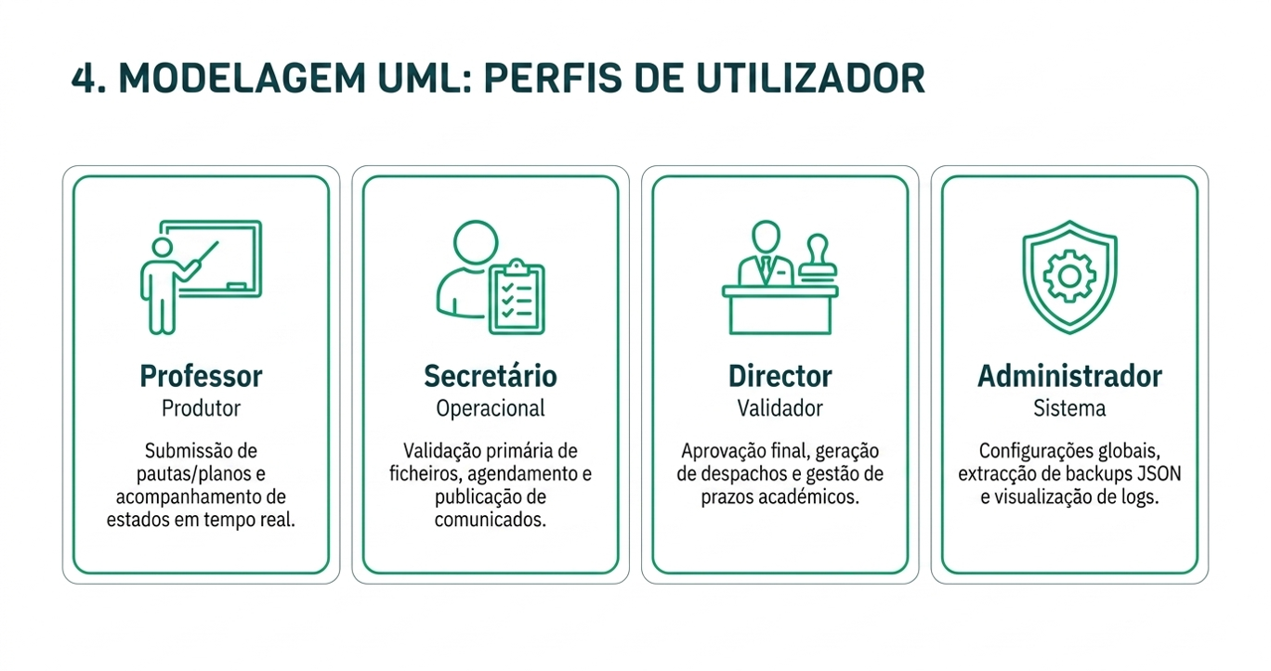

Slide 6
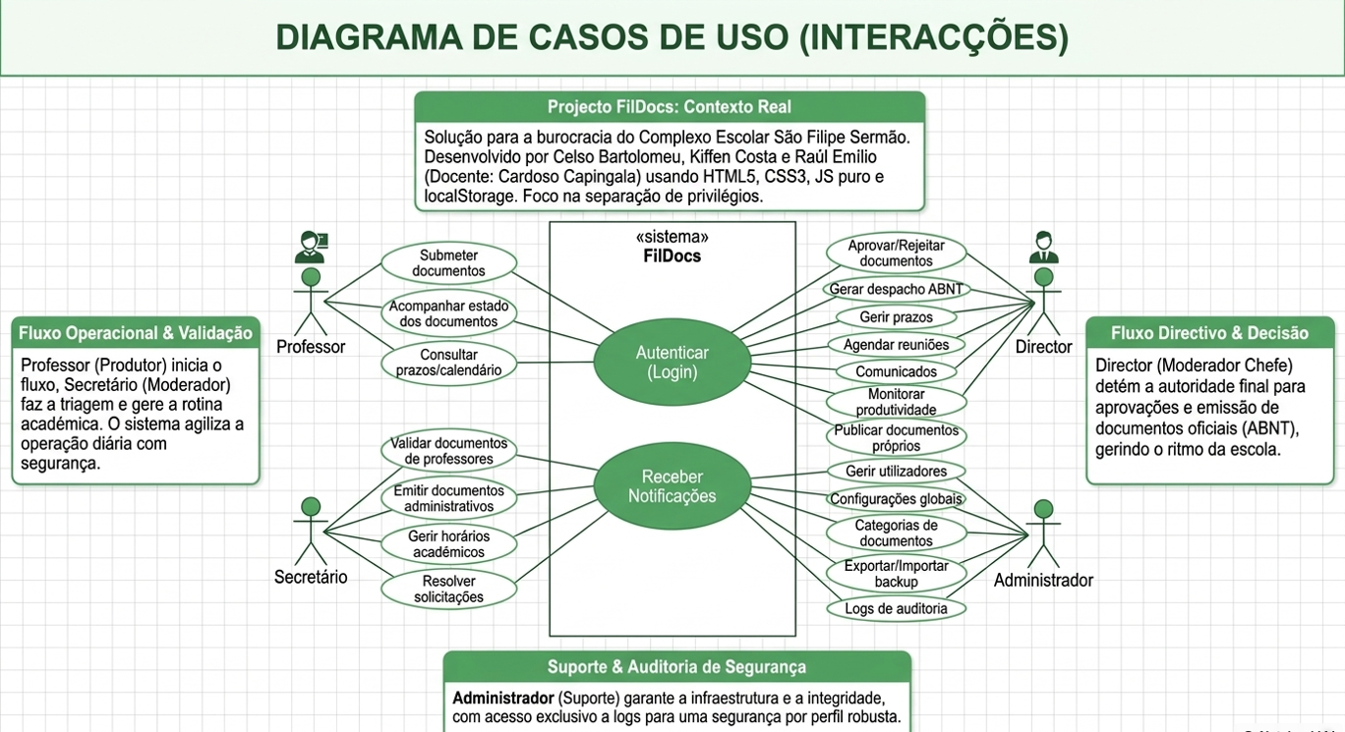

Slide 7
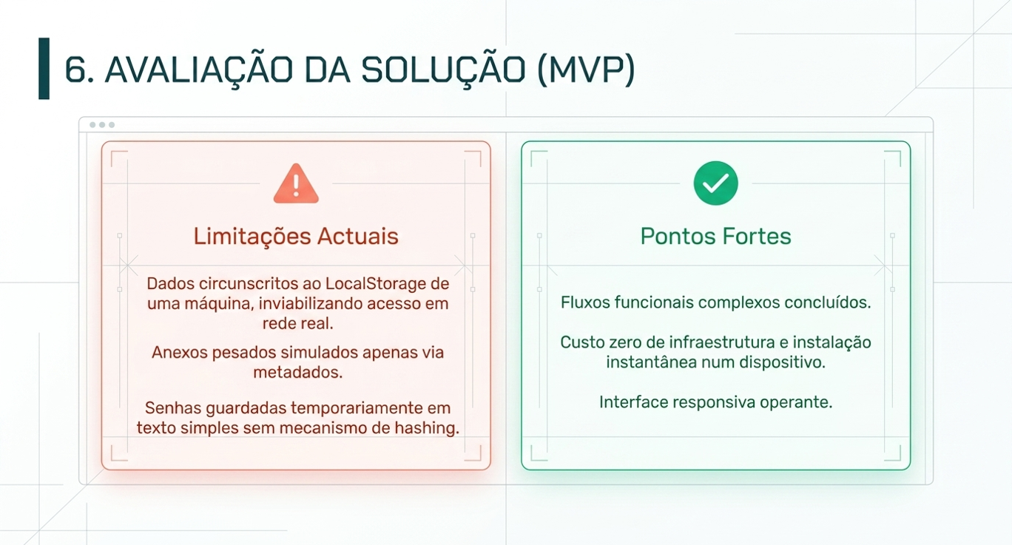

Slide 8
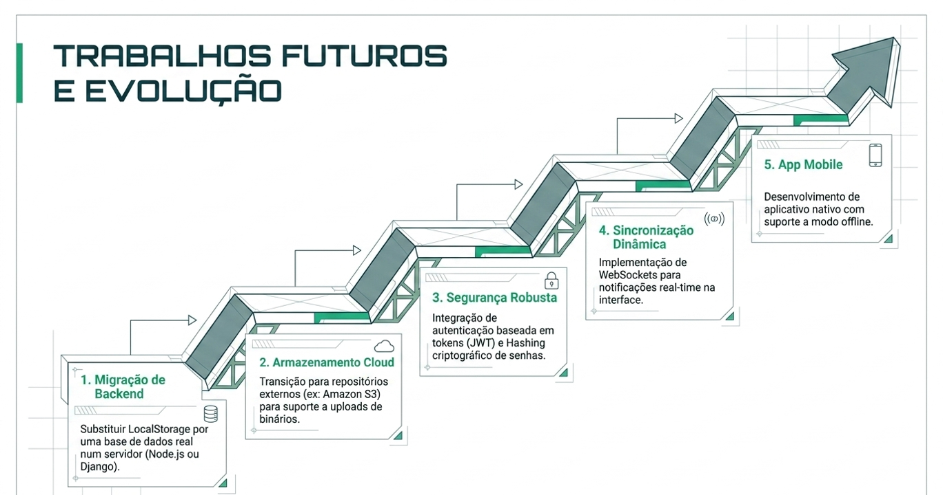

Slide 9
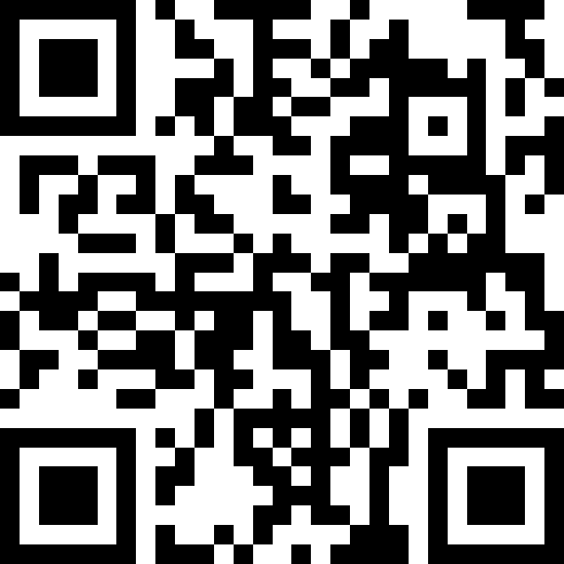
https://fildocs.netlify.app
Escaneie o QR Code ou acesse o link para aceder o sistema
Email: director@sfsermao.ao Password: Director@2025
Email: prof.amaro@sfsermao.ao Password: Prof@2025
Email: secretario@sfsermao.ao Password: Secretario@2025
Email: admin@sfsermao.ao
Password: Admin@2025

